Slide 1
Introduction to C
Shekh. Md. Saifur Rahman
Lecturer, Dept. of CSE
United International University
Email: saifur@cse.uiu.ac.bd
Courtesy: Tasmin Sanjida Mam

Slide 2
What is C Programming Language
C programming language is:
General-purpose programming language
Popular, simple, and flexible to use
Structured programming language
Lecturer Saifur Rahman, Dept. of CSE, United International University

Slide 3
Structure of C Program
A C program basically consists of the following parts:
Preprocessor Commands
Functions
Variables
Statements & Expressions
Comments
Lecturer Saifur Rahman, Dept. of CSE, United International University

Slide 4
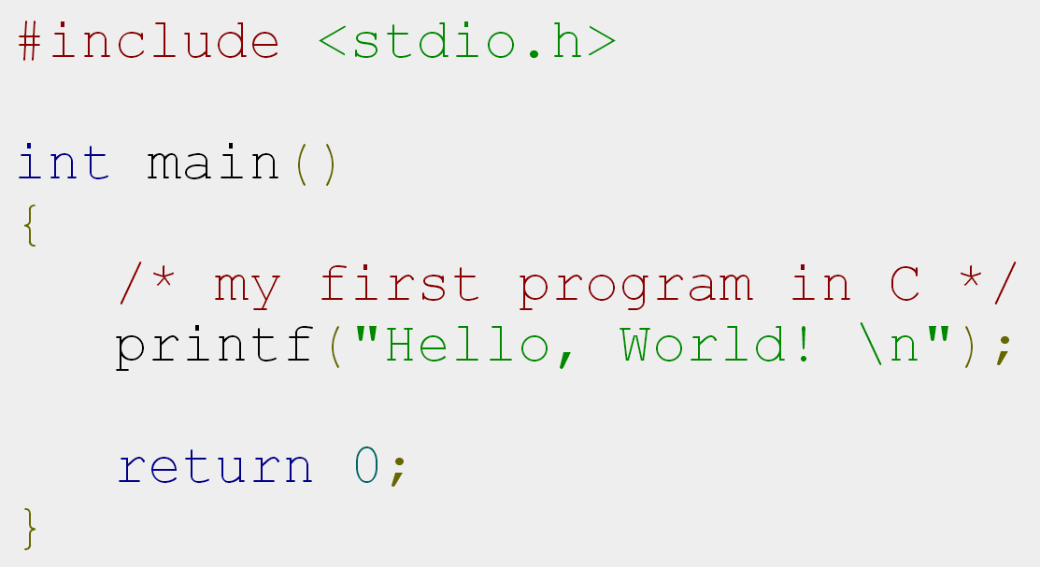
Structure of C Program
Preprocessor Commands
Main Function
Comment
Library Function
End of Program
Lecturer Saifur Rahman, Dept. of CSE, United International University

Slide 5
Preprocessor Commands
These commands tells the compiler to do preprocessing before doing actual compilation.
Like #include <stdio.h> is a preprocessor command which tells a C compiler to include stdio.h file before going to actual compilation.
Lecturer Saifur Rahman, Dept. of CSE, United International University

Slide 6
Functions
Functions are main building blocks of any C Program.
Every C Program will have one or more functions and there is one mandatory function which is called main() function.
The C Programming language provides a set of built-in functions.
In the above example printf() is a C built-in function which is used to print anything on the screen.
Lecturer Saifur Rahman, Dept. of CSE, United International University

Slide 7
Comments
Comments are used to give additional useful information inside a C Program.
All the comments will be put inside /*...*/ as given in the example above.
A comment can span through multiple lines.
/* comment for multiple line */
// single line comment
Lecturer Saifur Rahman, Dept. of CSE, United International University

Slide 8
Some Basic Functions
printf(); // to print anything in C
scanf(); // to take input from user
Lecturer Saifur Rahman, Dept. of CSE, United International University

Slide 9
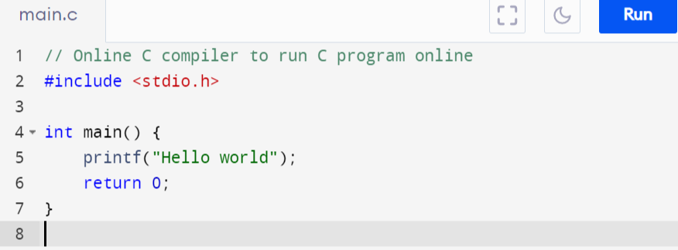
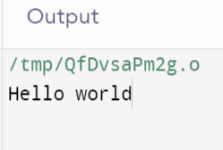
Lecturer Saifur Rahman, Dept. of CSE, United International University

Slide 10
Variable and Variable Declaration
Variable is a named memory location that can hold various values.
All variables must be declared before they can be used.
When we declare a variable, we tell the compiler what type of variable is being used.
A declaration associates a group of variables with a specific data type.
Lecturer Saifur Rahman, Dept. of CSE, United International University

Slide 11
C’s Basic Data Type
Type | Keyword | format Specifier | Memory Requirements
Character data | char | %c | 1 Byte
Signed whole numbers | int | %d | 2 or 4 Byte
Floating-point numbers | float | %f | 4 Byte
Double-precision floating-point number | double | %lf | 8 Byte
valueless | void |  | ---
Lecturer Saifur Rahman, Dept. of CSE, United International University

Slide 12
How to Declare Variables
To declare a variable, use this general form:
type var-name;
In C, a variable declaration is a statement and it must end in a semicolon (;).
datatype variable_name ;
Lecturer Saifur Rahman, Dept. of CSE, United International University

Slide 13
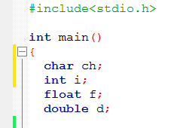
Lecturer Saifur Rahman, Dept. of CSE, United International University

Slide 14
Variable
Variables consist of letters and digits, in any order, except that the first character must be a letter.
Both upper-and lowercase letters are permitted, though common usage favors the use of lowercase letters for most types of variables.
Upper- and lowercase letters are not interchangeable (i.e., an uppercase letter is not equivalent to the corresponding lowercase letter.)
Lecturer Saifur Rahman, Dept. of CSE, United International University

Slide 15
Variable (cont.)
The underscore character (_) can also be included, and is considered to be a letter.
An underscore is often used in the middle of an variable.
A variable may also begin with an underscore, though this is rarely done in practice.
Lecturer Saifur Rahman, Dept. of CSE, United International University

Slide 16
Variable (cont.)
Case-sensitive
COUNT and count are not same
As a rule, an identifier should contain enough characters so that its meaning is readily apparent.
On the other hand, an excessive number of characters should be avoided.
Lecturer Saifur Rahman, Dept. of CSE, United International University

Slide 17
Variable (Cont.)
Can not Use blank space
Can not Use any keyword
Can use letter of alphabet (A-Z, a-z)
Variable
The first character must be a letter
Digits (0-9)
Can not start a variable name with digit
Underscore (_)
Lecturer Saifur Rahman, Dept. of CSE, United International University

Slide 18

Is it Valid Variable Name?
Apon
1joty
joty-5
apon
apon123
this_is_a_long_name
_sojeb_1
VaReNdRa
Lecturer Saifur Rahman, Dept. of CSE, United International University

Slide 19
Is it Valid Variable Name?
4th
The first character must be letter
“x”
Illegal characters (“)
Order-no
Illegal characters (-)
My variable
Illegal characters (blank space)
Lecturer Saifur Rahman, Dept. of CSE, United International University

Slide 20
Identifiers
Identifiers are names that are given to various program elements, such as variables, functions and arrays.
Lecturer Saifur Rahman, Dept. of CSE, United International University

Slide 21
Keywords
There are certain reserved words, called Keywords, that have standard, predefined meaning in C
Can be used only for their intended purpose
Can't use as identifiers
Lecturer Saifur Rahman, Dept. of CSE, United International University

Slide 22
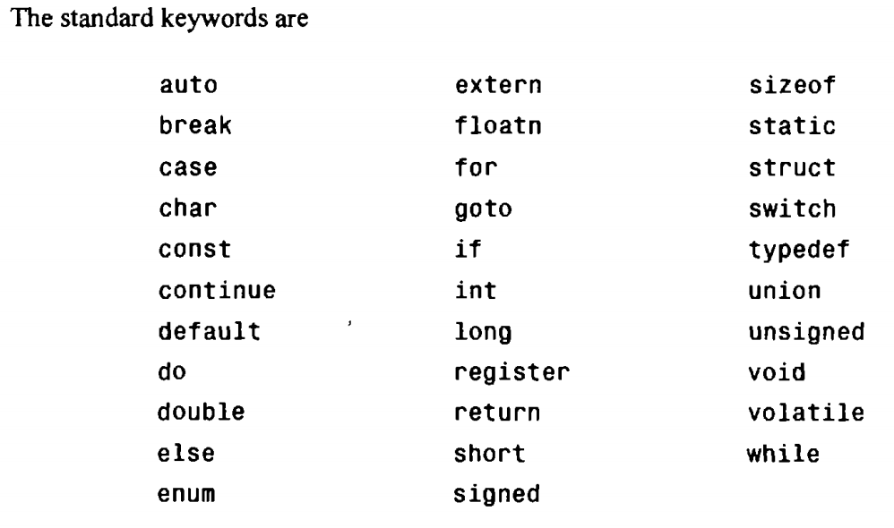
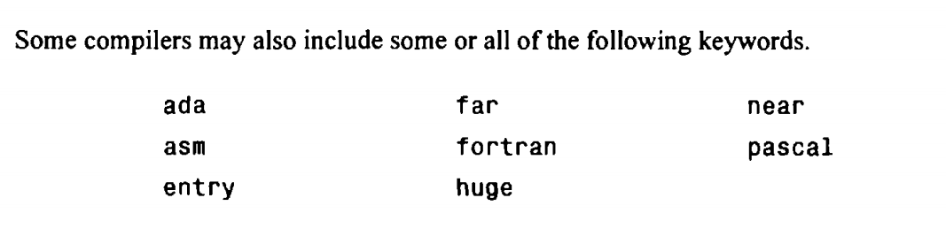
Keywords
Lecturer Saifur Rahman, Dept. of CSE, United International University

Slide 23
Expressions
An expression is a combination of operators and operands.
C expressions follow the rule of algebra
Expression | Operator
Arithmetic Expression | +, -, *, /, %
Logical Expression | AND, OR, NOT
Relational | ==, !=, <, >, <=, >=
Lecturer Saifur Rahman, Dept. of CSE, United International University

Slide 24
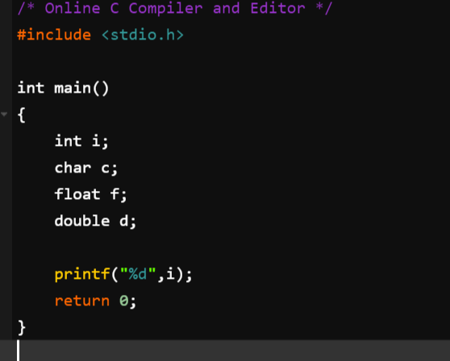

Output
Lecturer Saifur Rahman, Dept. of CSE, United International University

Slide 25
Assign value to variable
To assign a value to a variable, put its name to the left of an equal sign (=).
Put the variable you want to give the variable to the right of the equal sign.
It is a statement, so end with a ‘;’
variable
value
;
Lecturer Saifur Rahman, Dept. of CSE, United International University

Slide 26
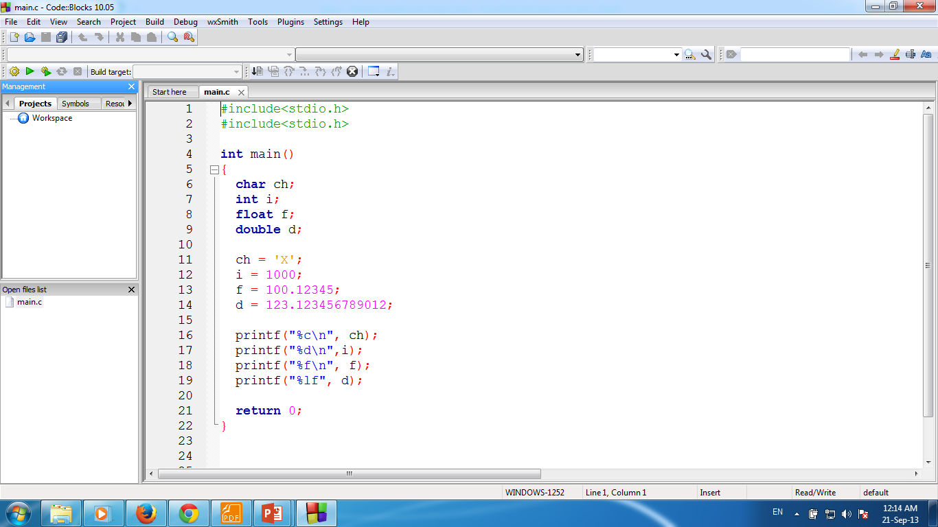
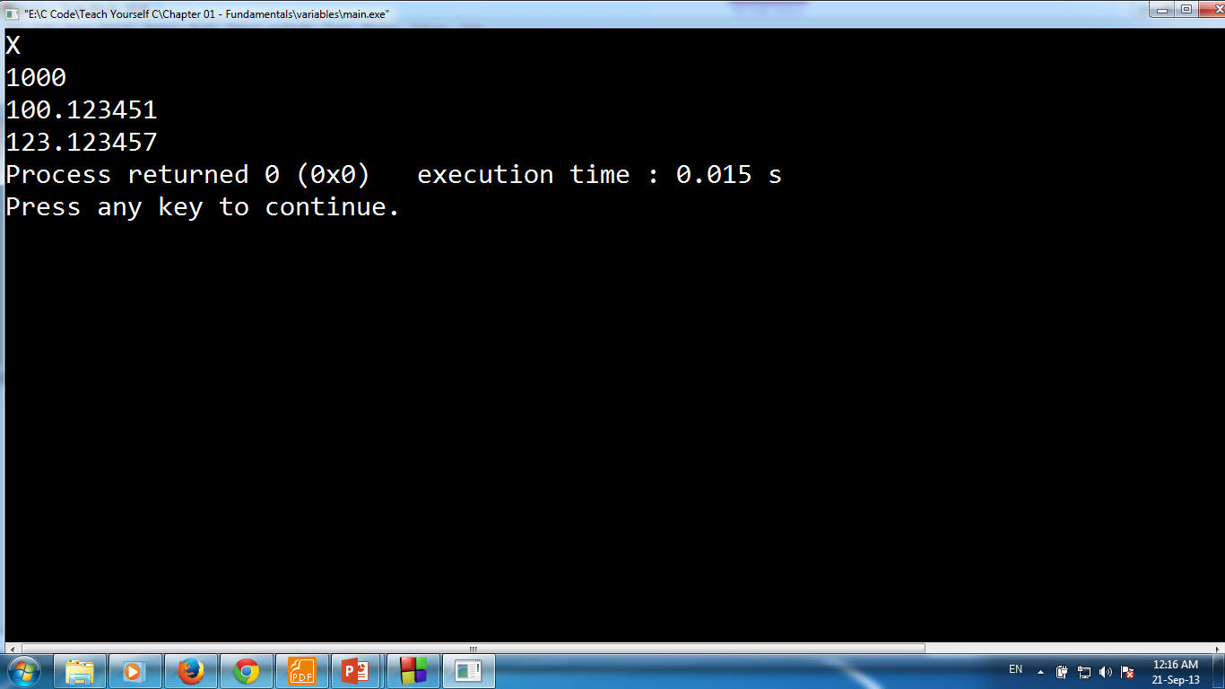
Lecturer Saifur Rahman, Dept. of CSE, United International University

Slide 27
Input Numbers From Keyboard
There are several methods
The easiest is – scanf() function.
Input from Keyboard
Lecturer Saifur Rahman, Dept. of CSE, United International University

Slide 28
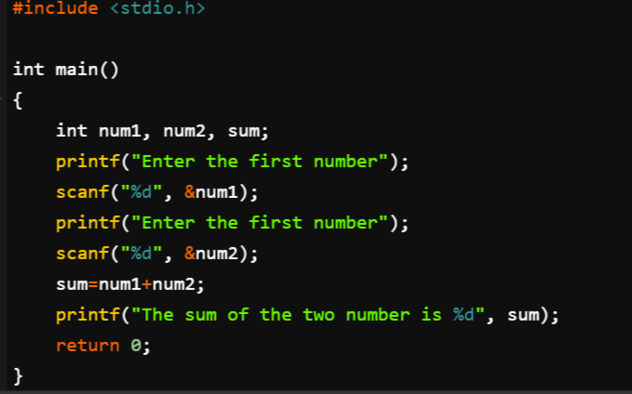
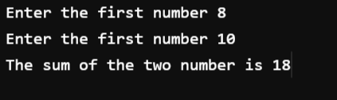
Output
Lecturer Saifur Rahman, Dept. of CSE, United International University

Slide 29
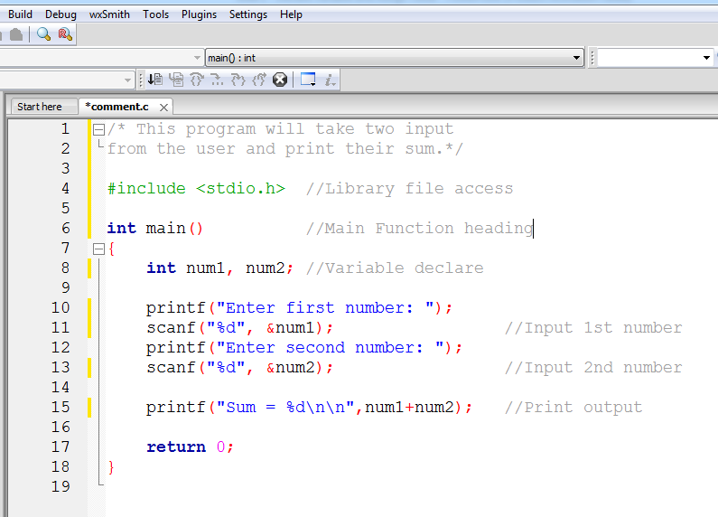
Lecturer Saifur Rahman, Dept. of CSE, United International University

Slide 30
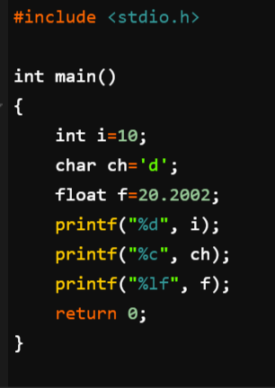

Output
Lecturer Saifur Rahman, Dept. of CSE, United International University

Slide 31
Escape Sequences
There are certain characters in C when they are preceded by a backslash (\) they will have special meaning.
They are used to represent like newline (\n) or tab (\t).
Lecturer Saifur Rahman, Dept. of CSE, United International University

Slide 32
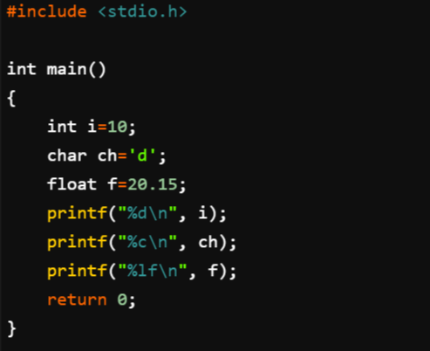
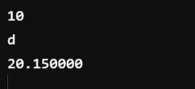
Output
Lecturer Saifur Rahman, Dept. of CSE, United International University

Slide 33
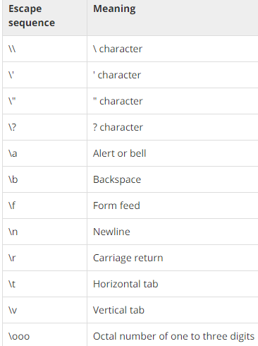
Escape Sequences
Lecturer Saifur Rahman, Dept. of CSE, United International University

Slide 34
Defining Constants
There are two simple ways in C to define constants:
Using #define preprocessor.
Using const keyword.
Lecturer Saifur Rahman, Dept. of CSE, United International University

Slide 35

Using #define preprocessor
Following is the form to use #define preprocessor to define a constant:
Symbolic constants are usually defined at the beginning of a program.
Name of the constant
Can be any valid identifier name
Constant value
Can be character/numeric/string
Lecturer Saifur Rahman, Dept. of CSE, United International University
Notes:
A symbolic constant is a name that substitutes for a sequence of characters.
The characters may represent a numeric constant, a character constant or a string constant.
Thus, a symbolic constant allows a name to appear in place of a numeric constant, a character constant or a string.
When a program is compiled, each occurrence of a symbolic constant is replaced by its corresponding character sequence.

Slide 36





Using #define preprocessor
Lecturer Saifur Rahman, Dept. of CSE, United International University
Notes:
A symbolic constant is a name that substitutes for a sequence of characters.
The characters may represent a numeric constant, a character constant or a string constant.
Thus, a symbolic constant allows a name to appear in place of a numeric constant, a character constant or a string.
When a program is compiled, each occurrence of a symbolic constant is replaced by its corresponding character sequence.

Slide 37
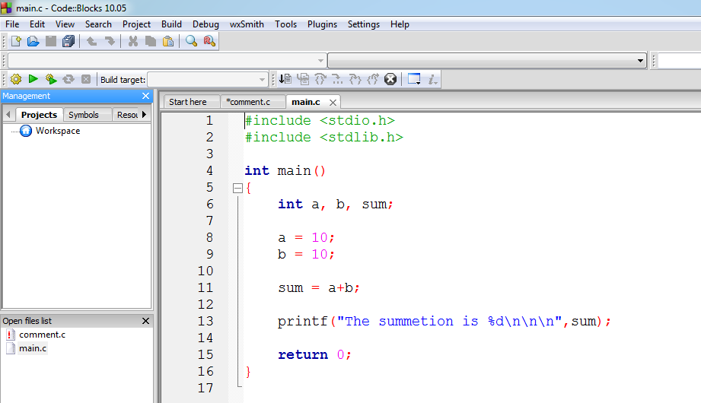
Symbolic Constants
Lecturer Saifur Rahman, Dept. of CSE, United International University

Slide 38
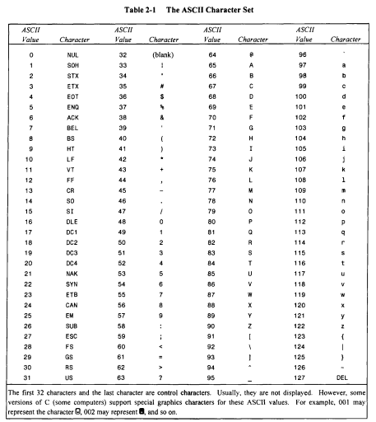
Lecturer Saifur Rahman, Dept. of CSE, United International University

